Slide 1

LOVELY PROFESSIONAL UNIVERISTY
Created by
Tirtharaj Barma
12218232

Slide 2

Book-Store Inventory App
GitHub

Slide 3
Introduction
Welcome to the Book-Store app, where literature meets technology. Our platform is designed to provide readers with an immersive experience, offering a vast collection of books at your fingertips. Join us on this journey of exploration and discovery.
Purpose
Expectations
Journey
Introducing the Book-Store app and its purpose in connecting readers with stories.
Offering an overview of the app's features and what the audience can expect from the presentation.
Inviting the audience to explore the world of literature and technology through the app.

Slide 4
Features Overview
Book Management
Server side
1. MongoDB Integration
Users can conveniently
upload, [ POST ]
delete, [ DELETE ]
update books, [ PATCH ]
Filter book category [ GET ]
This feature empowers administrators with efficient book management capabilities, enhancing the app's functionality.
Efficient database management for a vast collection of books.
2. Google Firebase Authentication
Secure login and sign-in processes supported by Google Firebase.

Slide 5
Modules used (dependencies)
MongoDB is a NoSQL database that provides a flexible and scalable way to store and manage data.
Express simplifies the process of building web servers and handling HTTP requests and responses
Nodemon is a utility tool for Node.js that automatically restarts the server when changes are detected in the codebase.
1. MongoDb
2. Express
3. Nodemon
4. Cors
5. DotEnv
a mechanism by which a front-end client can make requests for resources to an external back-end server
Allows developers to securely manage configuration variables such as database credentials, API keys,

Slide 6

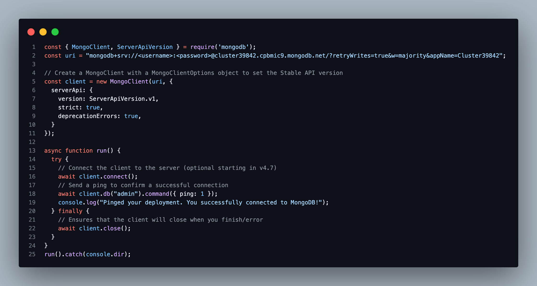
MongoDB Integration
Installation ->
npm install mongodb
Node.js script that connects to a MongoDB database using the official MongoDB Node.js driver.
Photos provided by Pexels

Slide 7
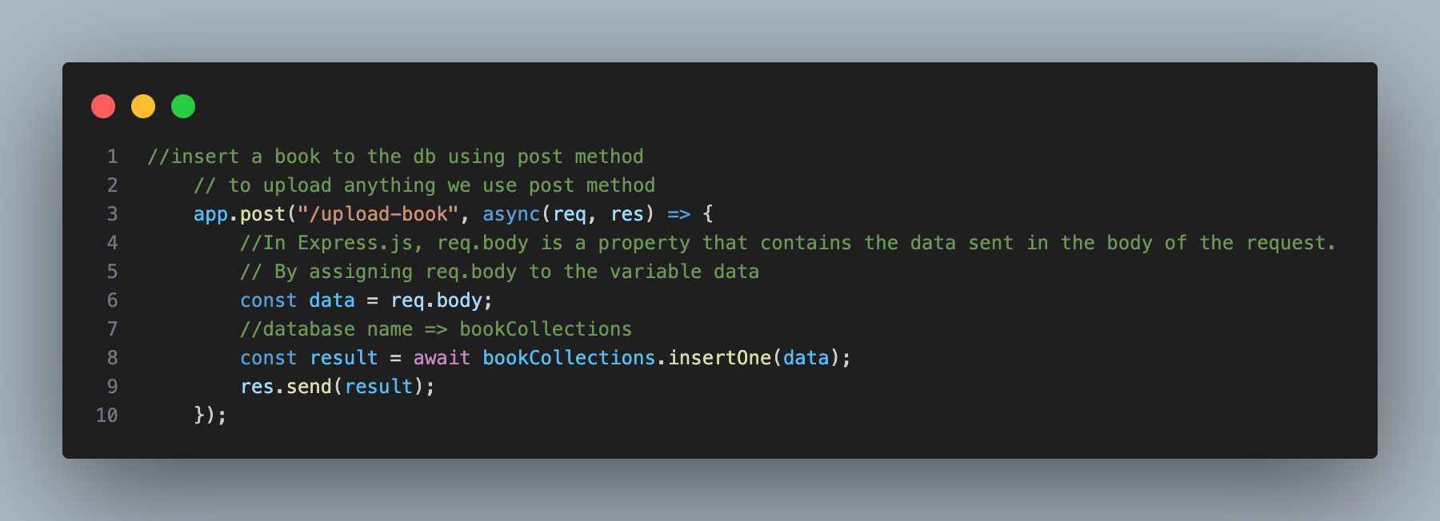
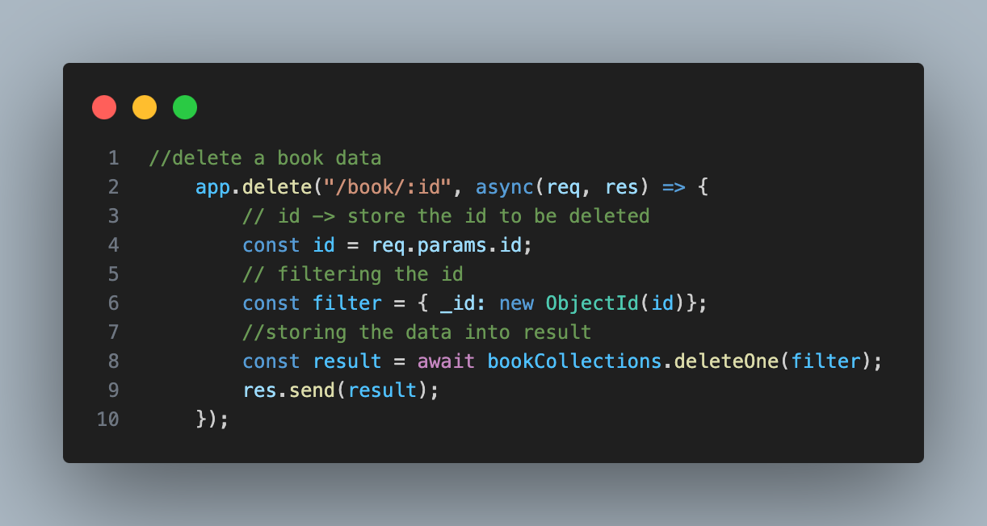
Server runs on PORT 5001 (local host)
POST Method
DELETE Method
Photos provided by Pexels

Slide 8
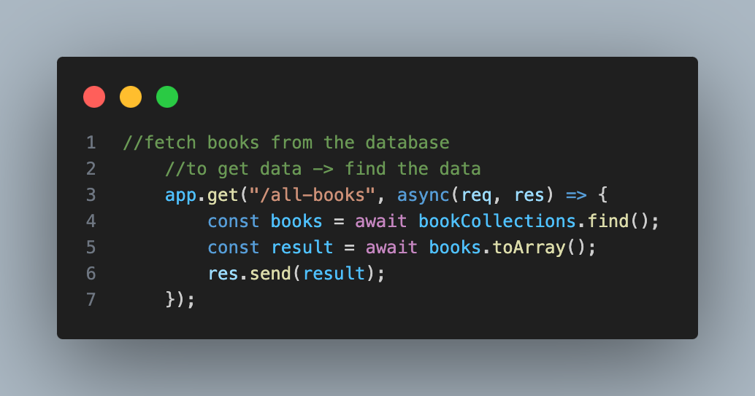
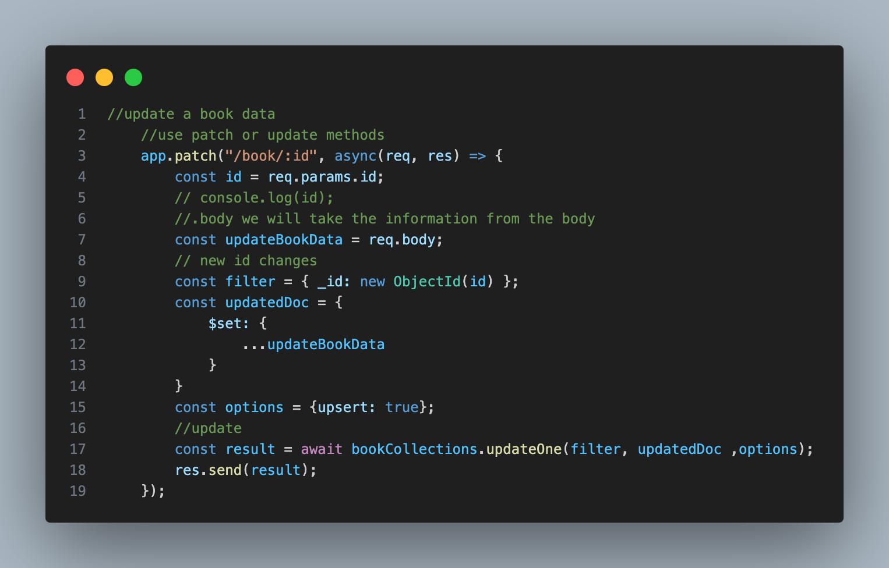
Server runs on PORT 5001 (local host)
Update Book
Fetch Book

Slide 9
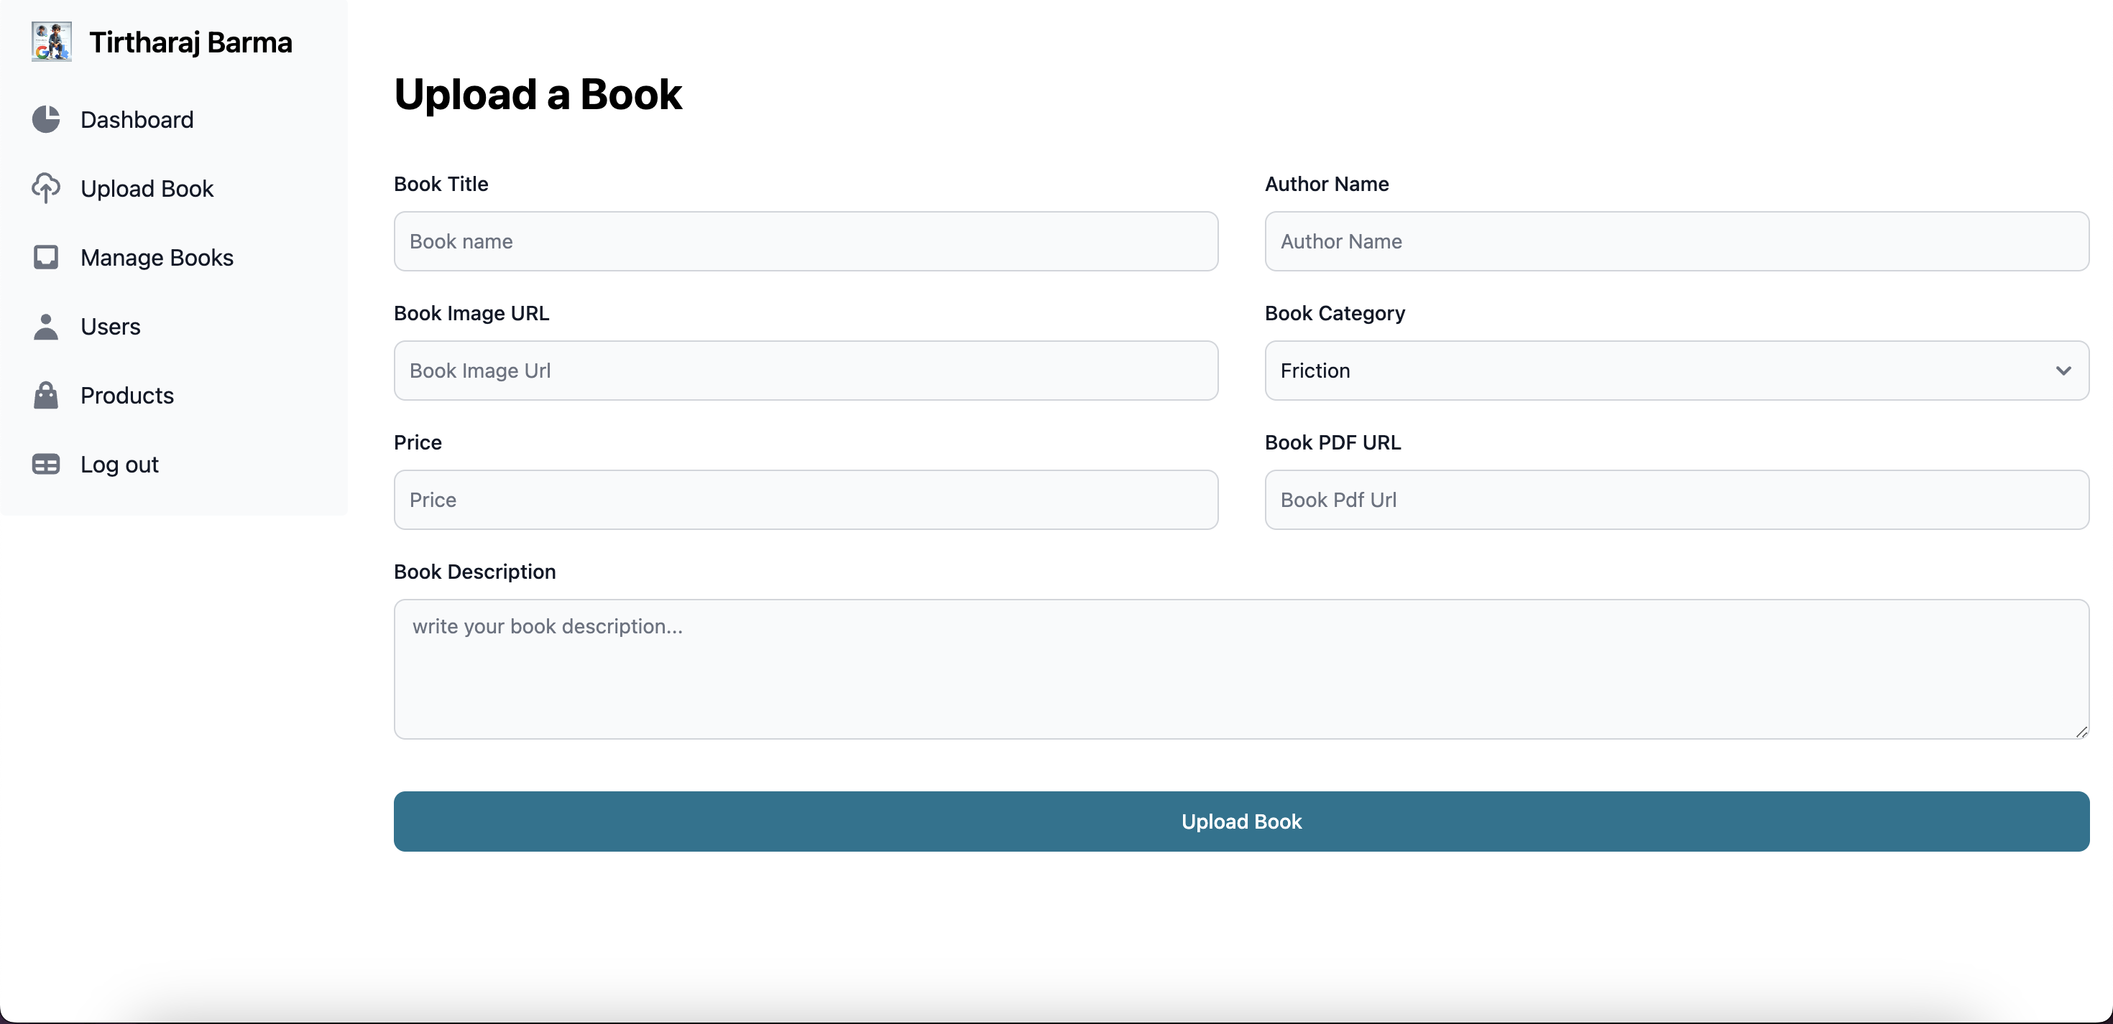
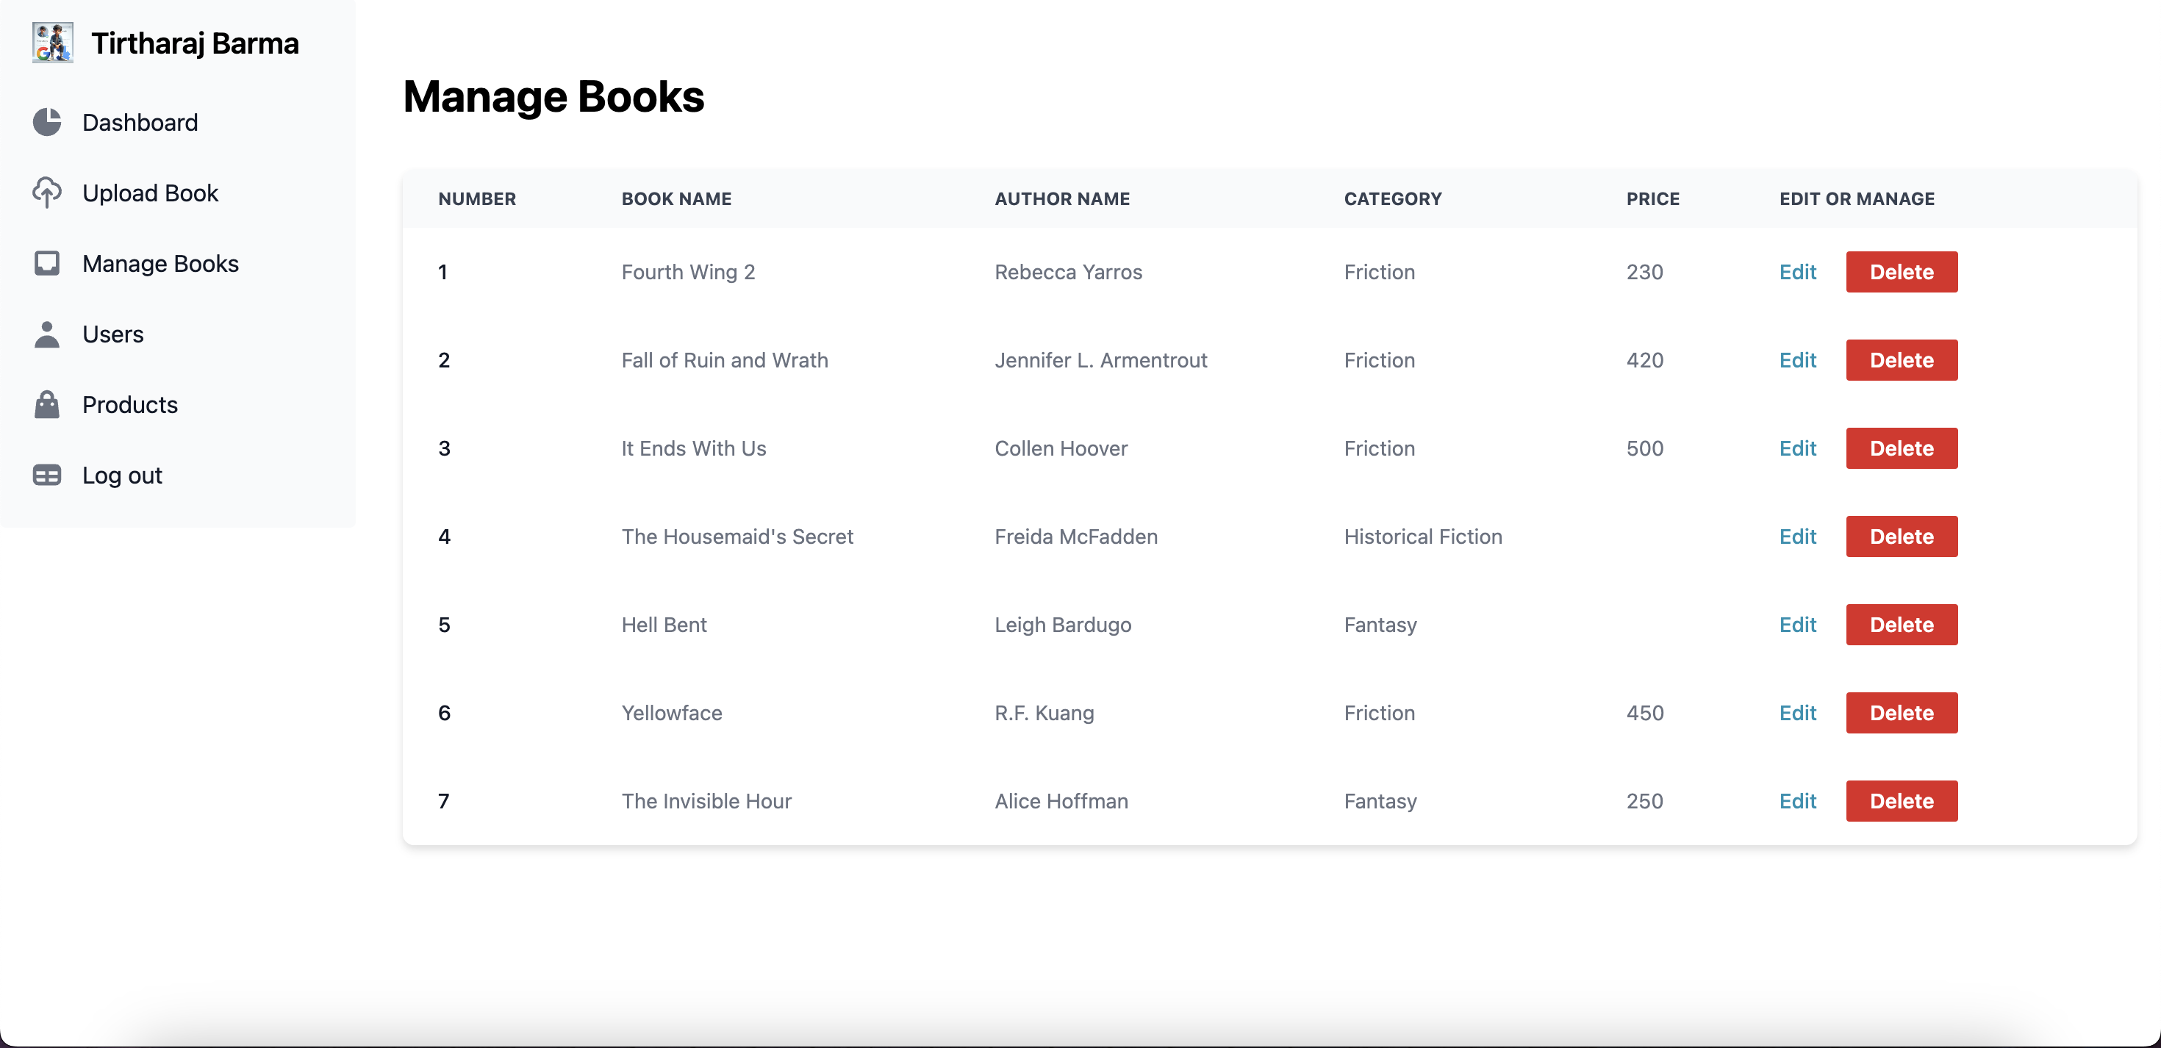
Admin Dashboard
Server running on PORT 5001 (local host)
Client running on PORT 5173 (Vite – React )
Upload Book Section
Update or Delete Book

Slide 10
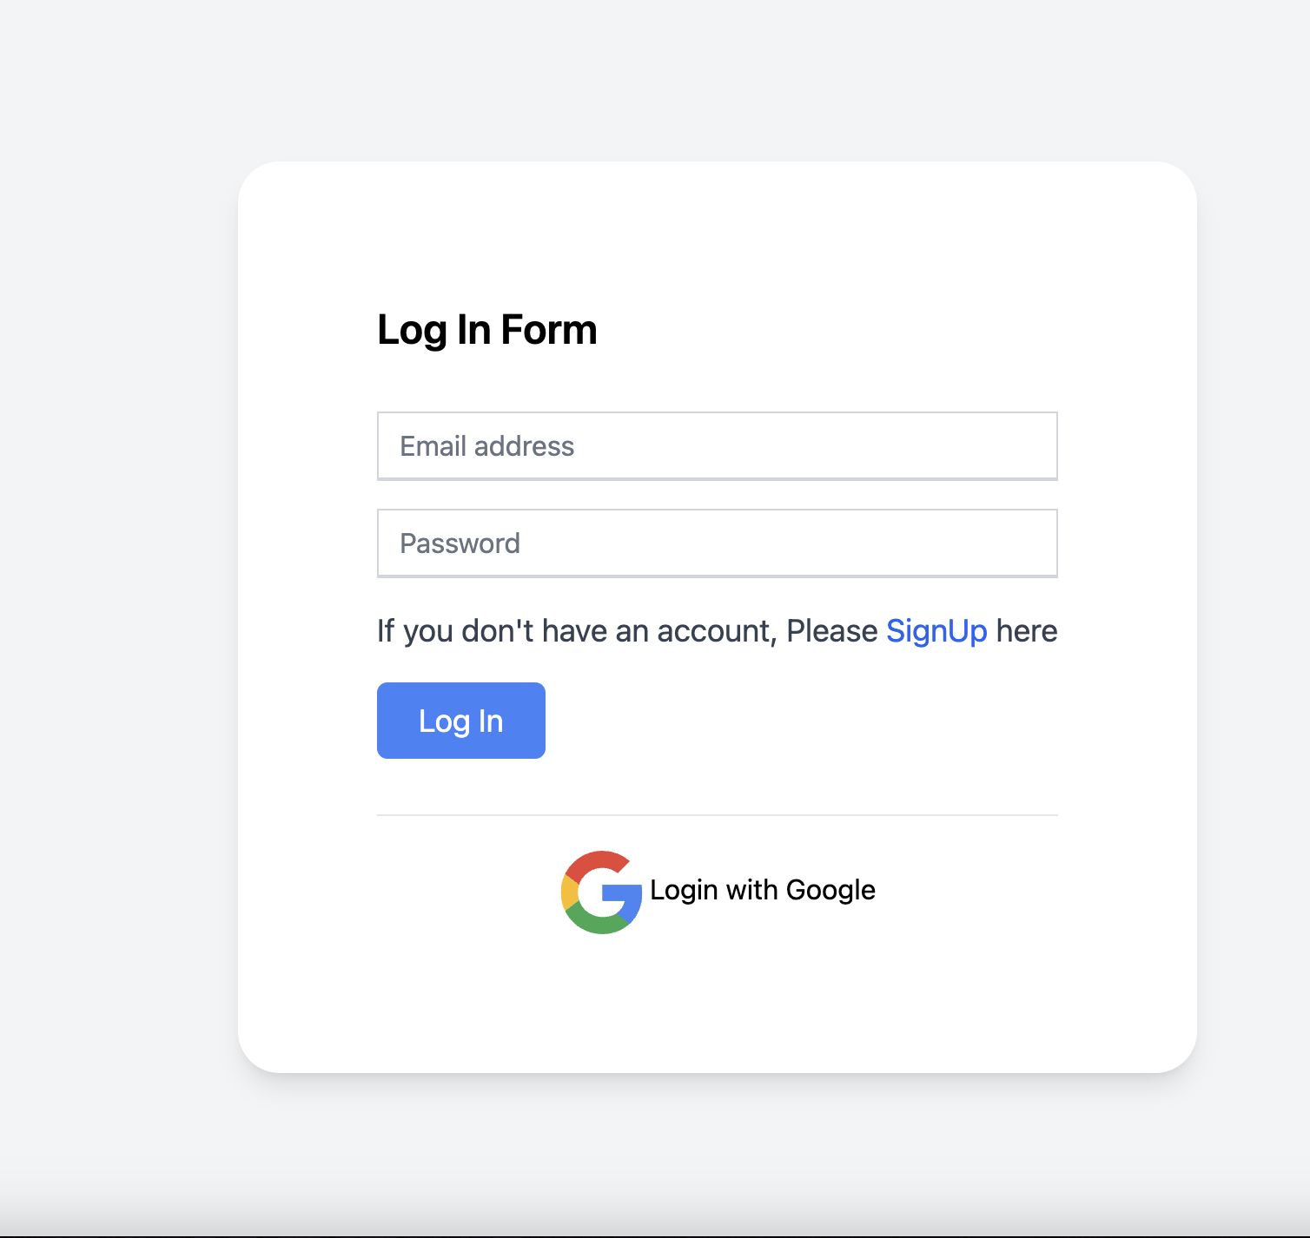
Google Firebase Authentication
Security
Convenience
Reliable authentication ensuring account security.
Hassle-free login/sign-in processes enhancing user experience.
Photos provided by Pexels

Slide 11
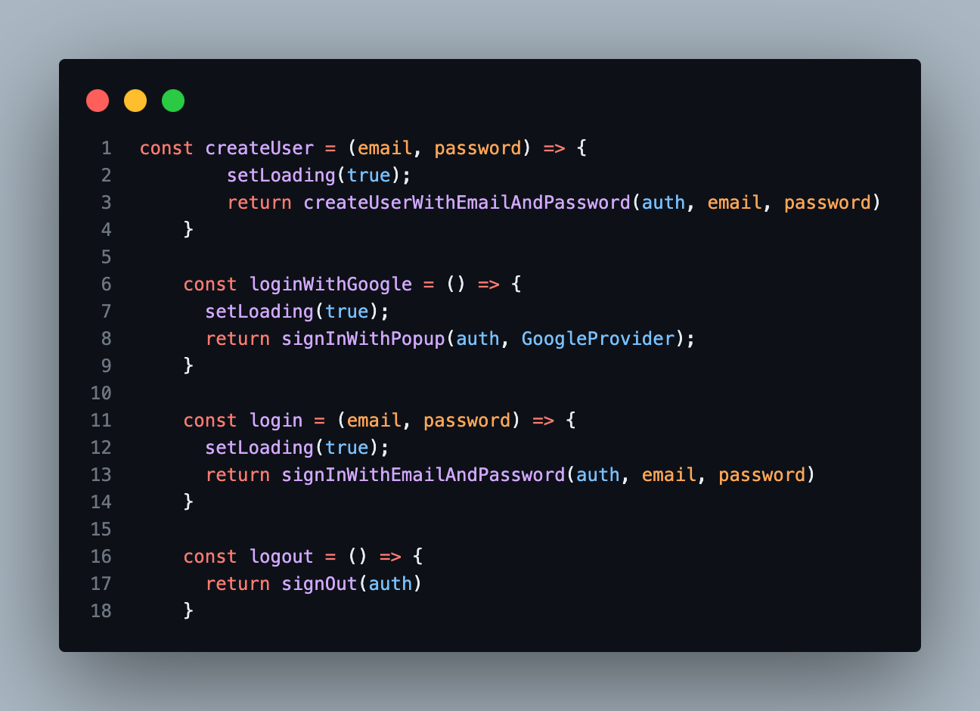
Google Firebase Authentication
Installation ->
npm install firebase
Method provided by Firebase Authentication
1. createUserWithEmailAndPassword 2. signInWithPopup 3. signInWithEmailAndpassword 4. signOut
Photos provided by Pexels

Slide 12
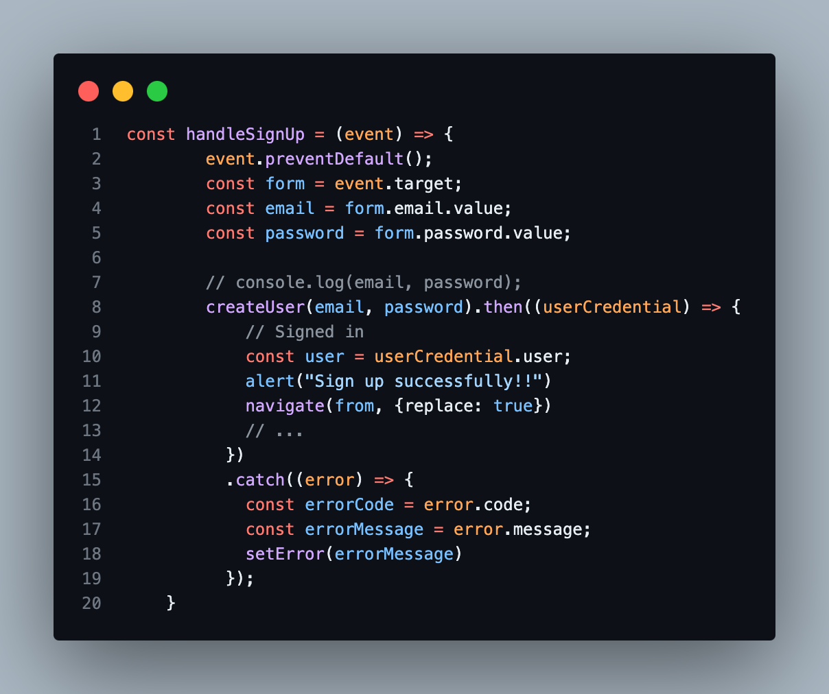
Google Firebase Authentication
SignUp
This function is presumably a wrapper around Firebase Authentication's createUserWithEmailAndPassword method, which creates a new user account with the provided email and password.

Slide 13
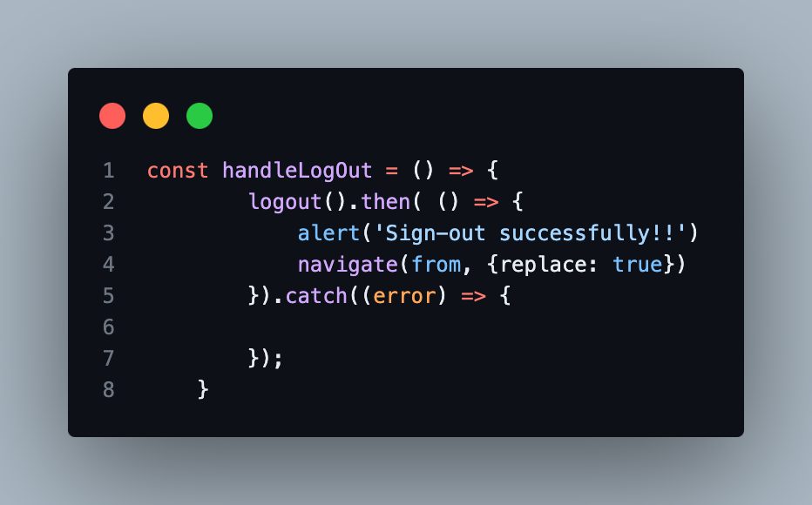
Google Firebase Authentication
Logout
When signOut(auth) is called, Firebase handles the sign-out process internally. It revokes the user's authentication token and clears any persisted authentication state.

Slide 14
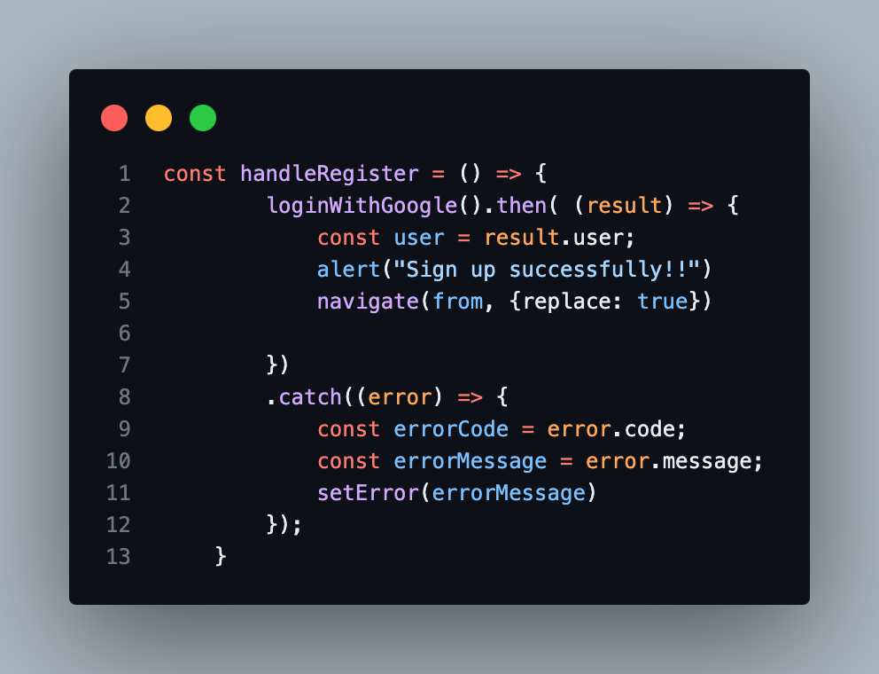
Google Firebase Authentication
Google Pop-up
The loginWithGoogle function returns a Promise, which resolves with the authentication result when the authentication process is successful or rejects if an error occurs during the process.

Slide 15
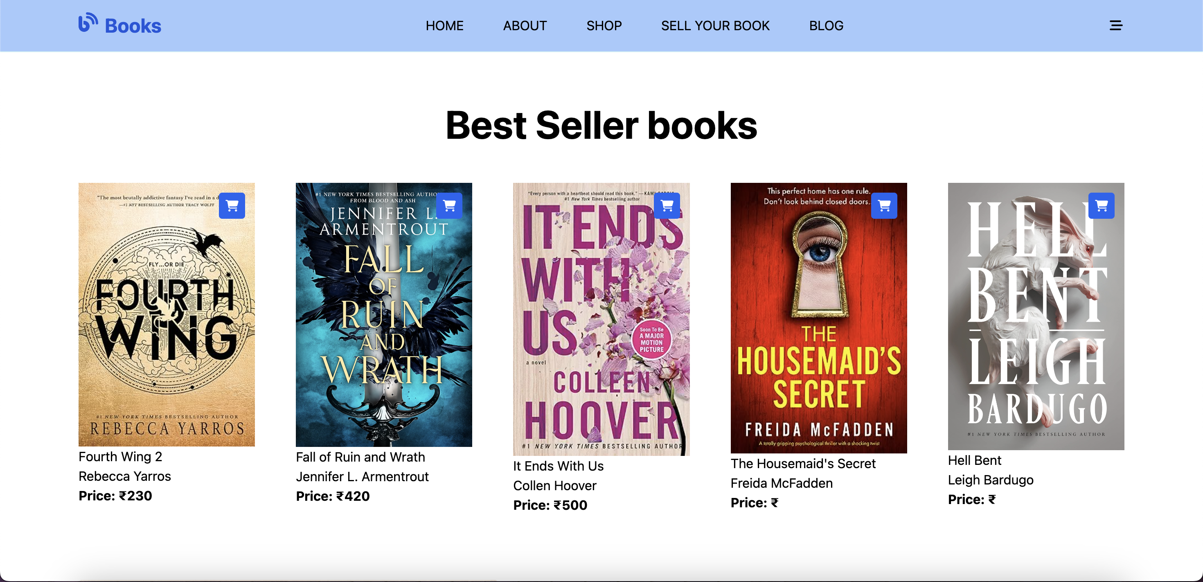
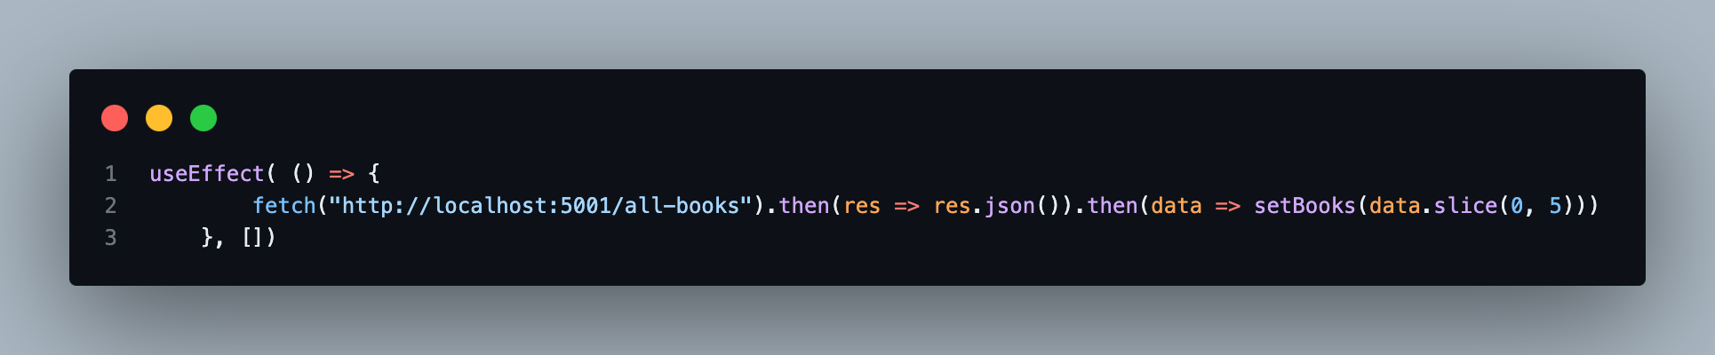
FRONTEND
Book Update Instantly between Backend - Frontend
FETCH the back-end server and address them 1. book.id 2. book.price 3. book.imageURL
4. book.bookTitle

Slide 16

Conclusion & Thank You
Summary
Gratitude
Recapping key points and takeaways from the presentation.
Expressing appreciation to the audience for joining the journey of literature and technology.
Photos provided by Pexels

